Slide 1
Car Workshop Management System
Dr.Ibrahim Abdellatif
Dr.Mostafa Ibrahim

Slide 2
Table of contents
01
02
03
04
Introduction
05
DFD
Problem Statement
06
SWOT
Related Work
07
Use Case
Proposed Solution
08
UI/UX

Slide 3
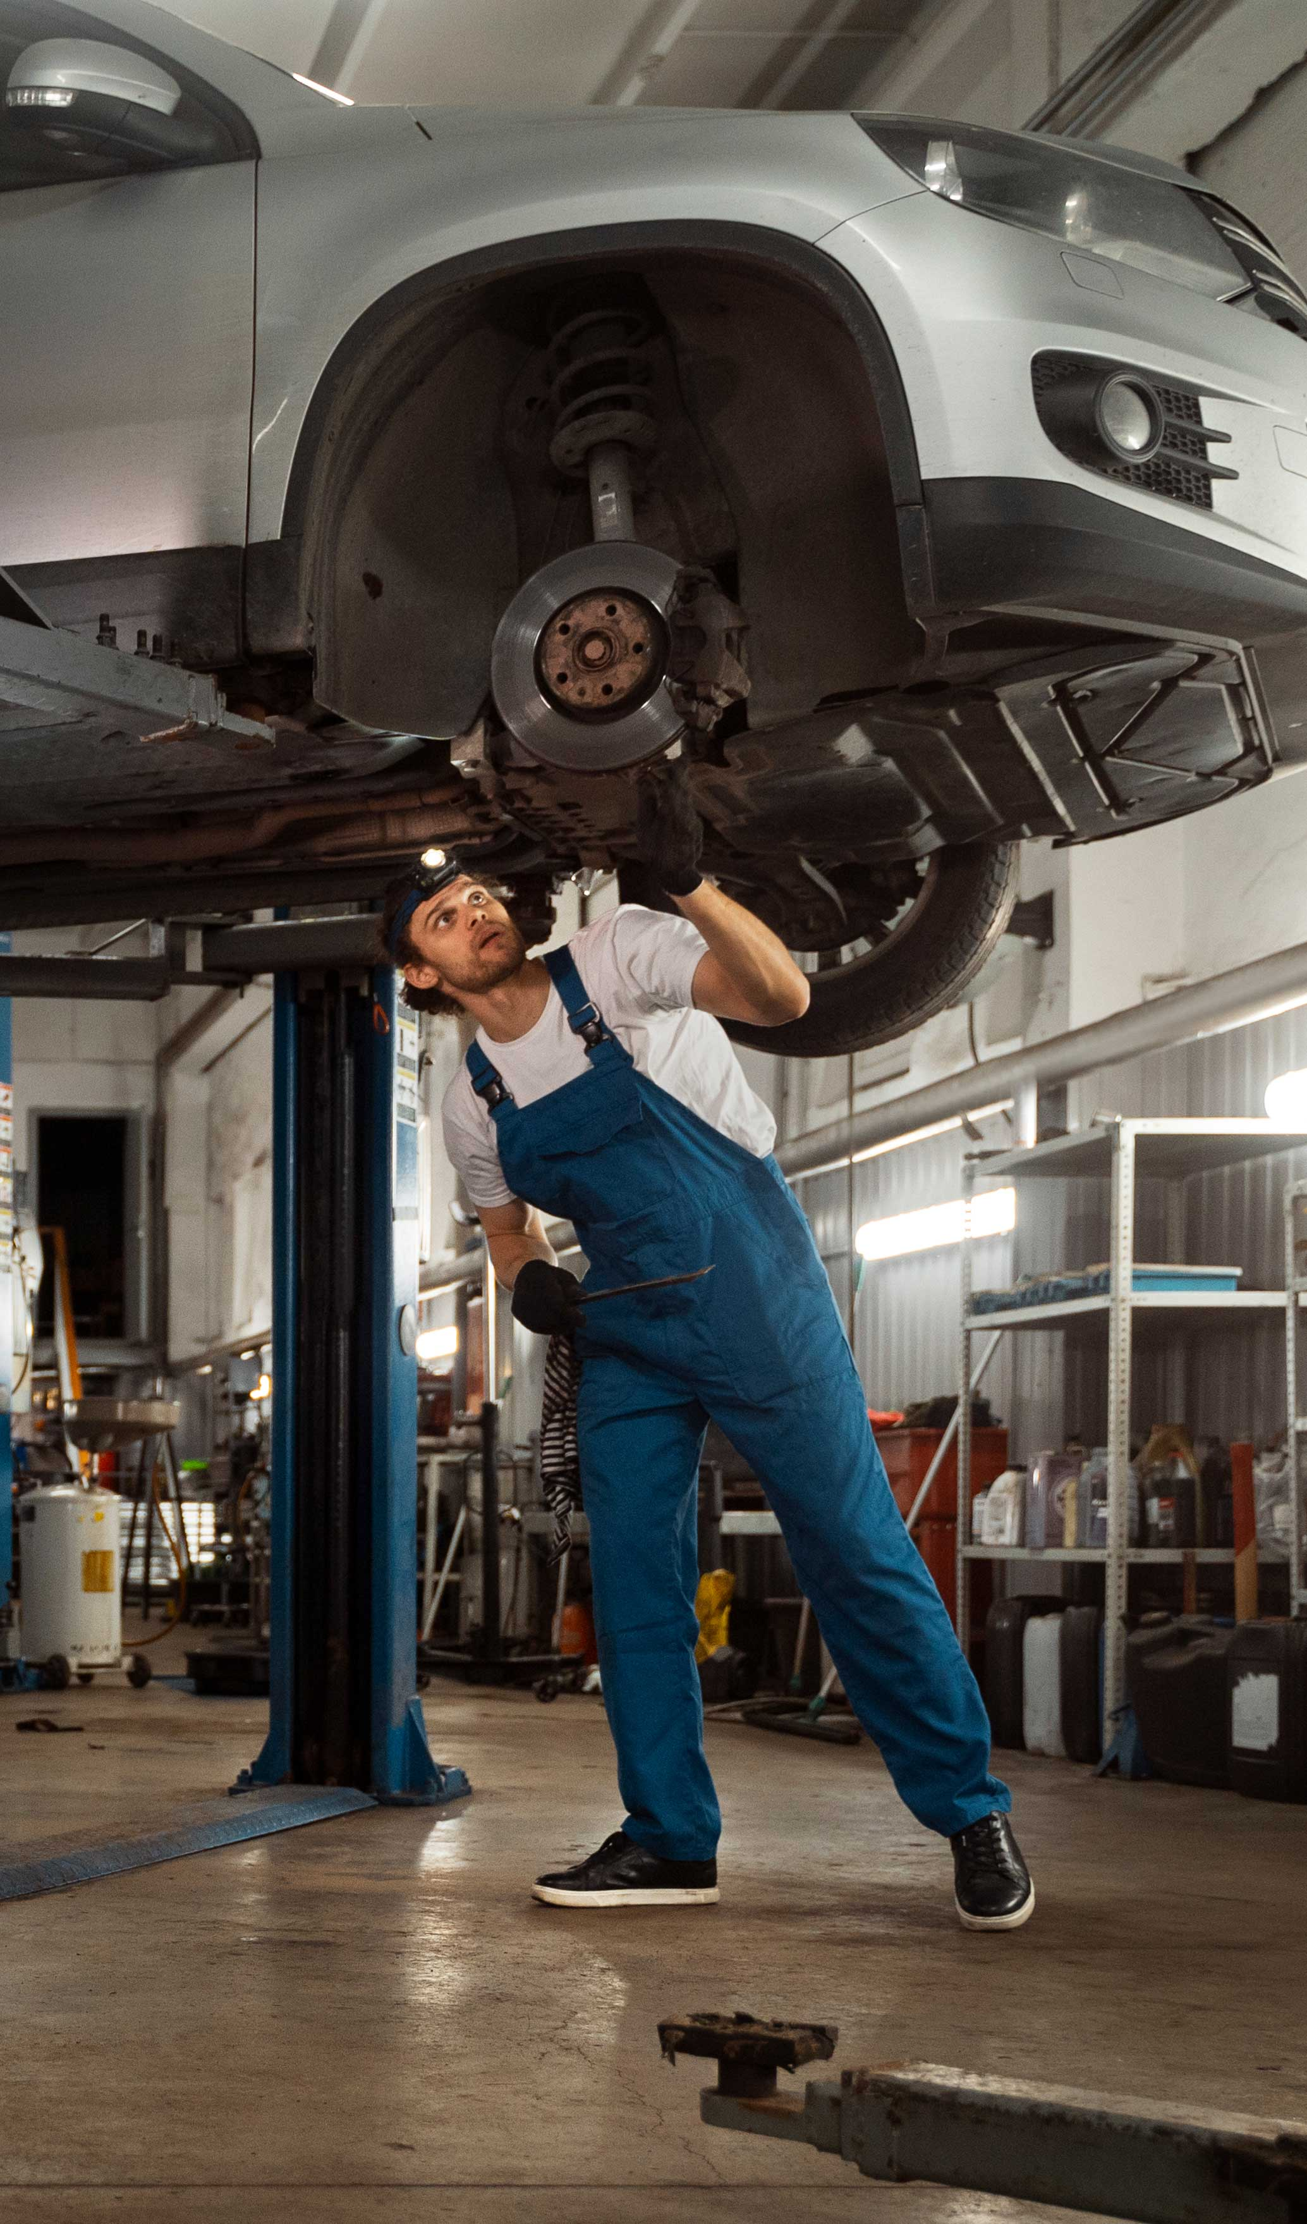
Introduction
In the fast-paced world of today, where convenience and efficiency are paramount, Warsha website emerges as a cutting-edge solution provider for vehicle owners and automotive service alike. This innovative website aims to revolutionize the way we approach car maintenance, making it easier, more transparent, and hassle-free.

Slide 4

Problem Statement
In the ever-evolving landscape of the automotive industry, the digital transformation has ushered in new opportunities and challenges for car owners and automotive repair centers alike. As car ownership becomes more prevalent, the need for efficient and effective communication between vehicle owners and repair centers is paramount. This report aims to identify and address the key problems and challenges associated with a website that serves as an intermediary between car owners seeking repair and the repair centers providing services.

Slide 5

Related Work
YourMechanic
Carvana
Fixd
Mechanic Advisor
RepairPal

Slide 6
Pros
Cons
Real-time Repair updates
Virtual car inspection
Interactive repair guide
Community forum
Real-time Repair updates not accurate
Not identify all repairs needs
May not be easy to follow
May not be moderated
not allowed in all counters

Slide 7
Proposed Solution
Customers can schedule appointments and track the progress of their repairs online.
Create a reporting module that compiles the processed data .
Our real-time repair updates keep customers informed about the status of their car and any potential delays.
Our interactive repair guide and community forum give customers access to the knowledge and expertise of experienced mechanics.

Slide 8
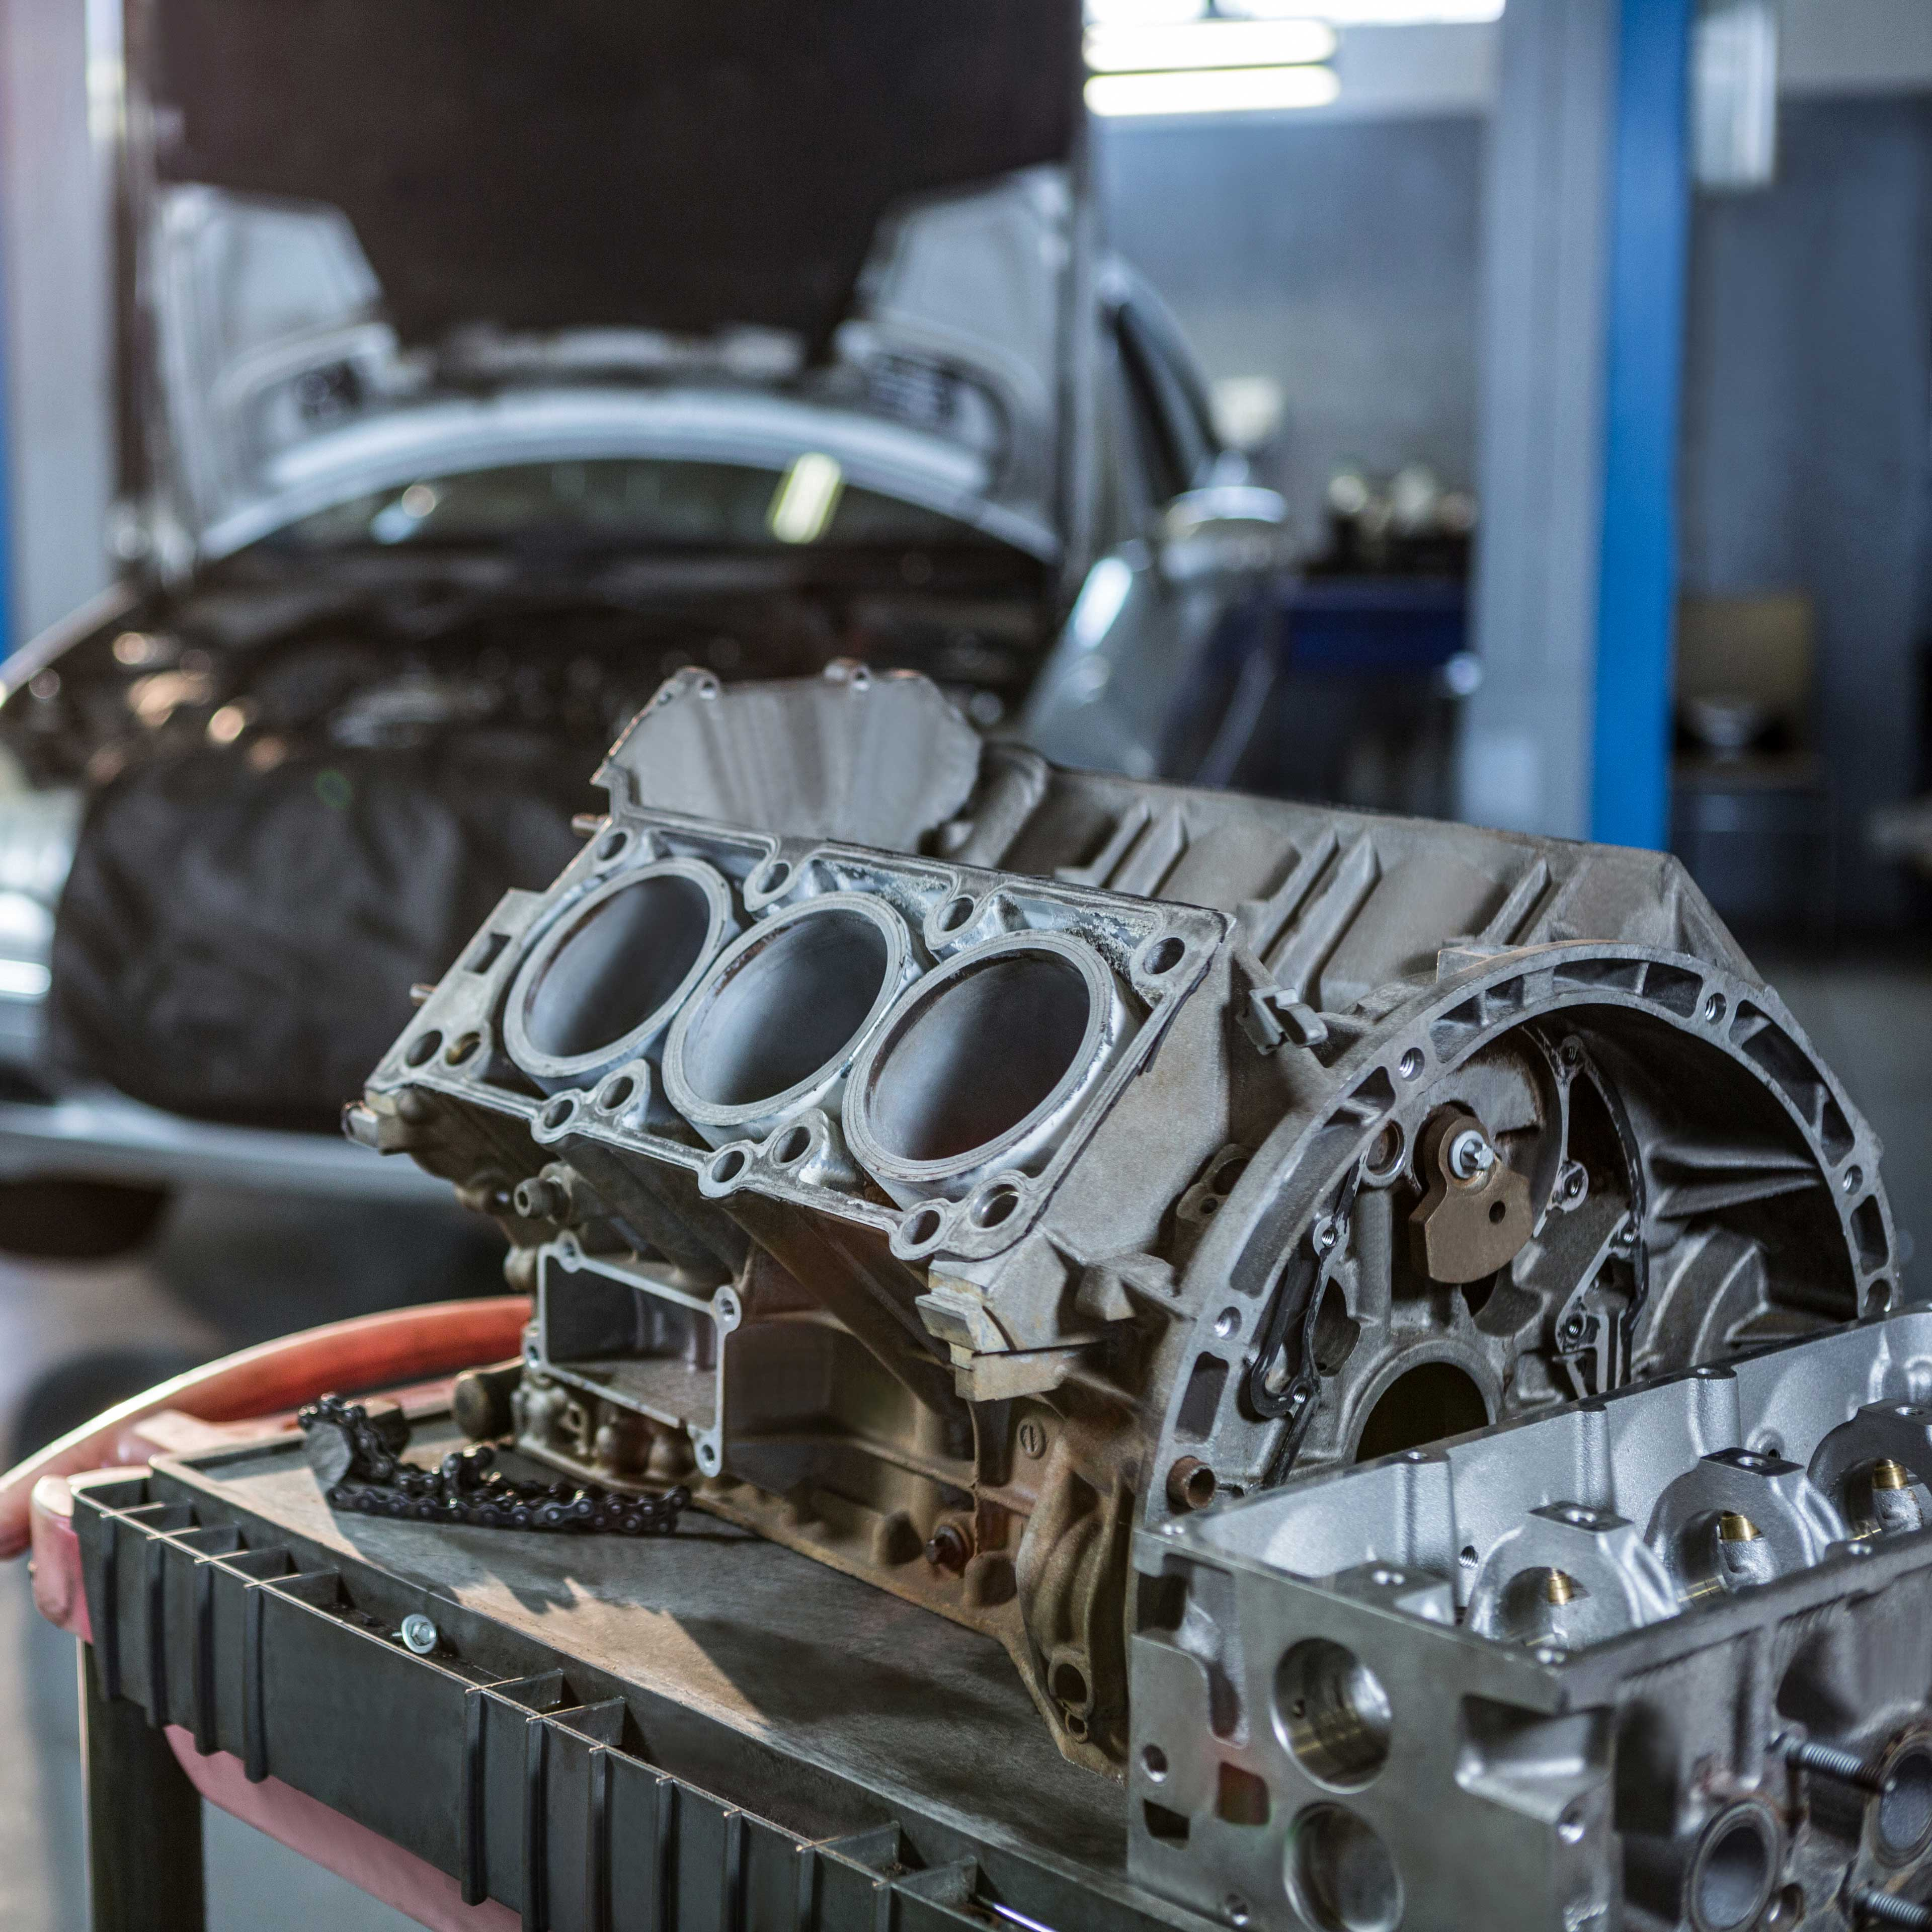
05
DFD

Slide 9
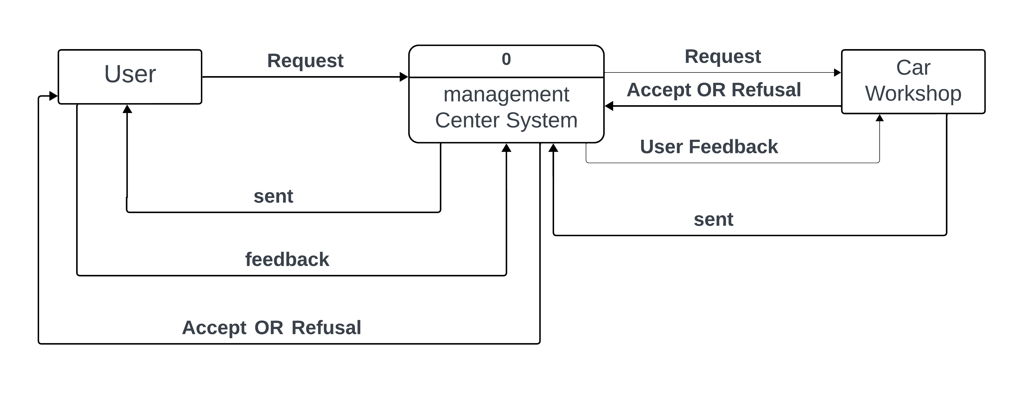

Slide 10
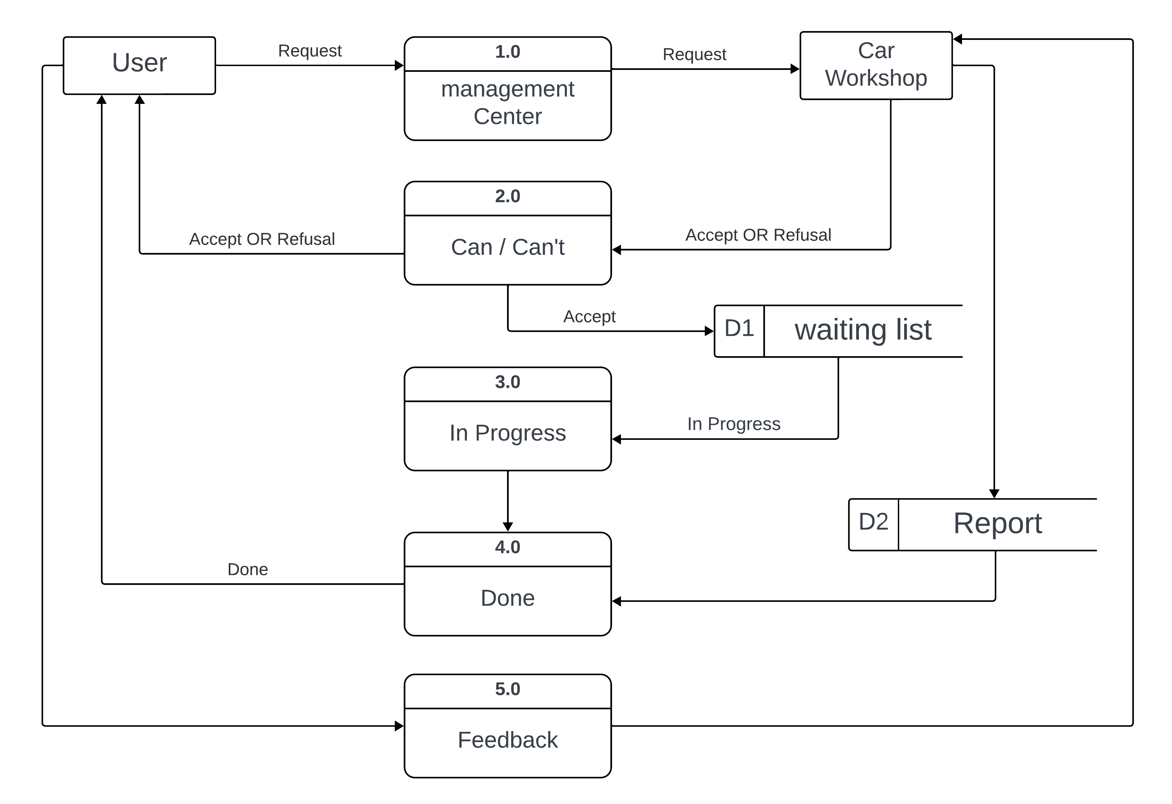

Slide 11
07
SWOT

Slide 12
Strengths
Convenience: The app allows customers to schedule appointments, track the progress of their repairs, and view their car's service history from anywhere, at any time.
Efficiency: The app streamlines the car repair process by automating tasks such as scheduling appointments and sending notifications to customers.
Transparency: The app provides customers with real-time updates on the status of their repairs, which helps to build trust and confidence.
Engagement: The app includes gamification elements, such as rewards and leaderboards, to make the car repair experience more engaging for customers.
Community: The app provides a forum where customers can connect with each other and share tips and advice.

Slide 13
Weaknesses
Dependence on technology: The app relies on technology, such as smartphones and internet access, which can be a barrier for some customers.
Limited scope: The app is currently focused on car repairs, but it could be expanded to include other services, such as oil changes and tire rotations.
Lack of personalization: The app does not currently provide personalized recommendations for repairs or maintenance.
Cost of development and maintenance: The app required a significant investment to develop and maintain.

Slide 14
Opportunities
Partnerships: The app could be partnered with car dealerships, insurance companies, and other businesses to reach a wider audience.
Data analytics: The app could collect and analyze data on customer behavior to identify trends and improve the app's features.
New markets: The app could be expanded to new markets, both domestically and internationally.
Integration with smart cars: The app could be integrated with smart cars to collect data on the car's health and performance.

Slide 15
Threats
Competition: There are a growing number of competitors in the car repair app space.
Changing customer expectations: Customer expectations are changing rapidly, and the app will need to keep up with these changes in order to remain competitive.
Data security: The app collects sensitive customer data, and it is important to protect this data from hackers.
Privacy concerns: Customers are becoming increasingly concerned about privacy, and the app will need to be transparent about its data collection and usage practices.

Slide 16
07
Use Case

Slide 17
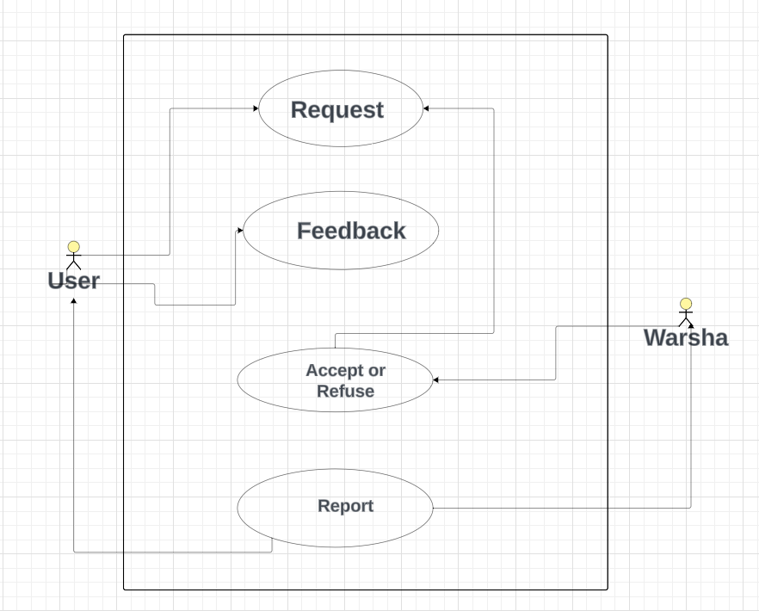

Slide 18
08
UI/UX

Slide 19
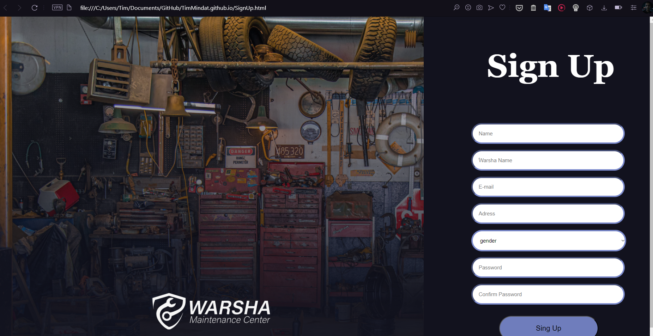

Slide 20
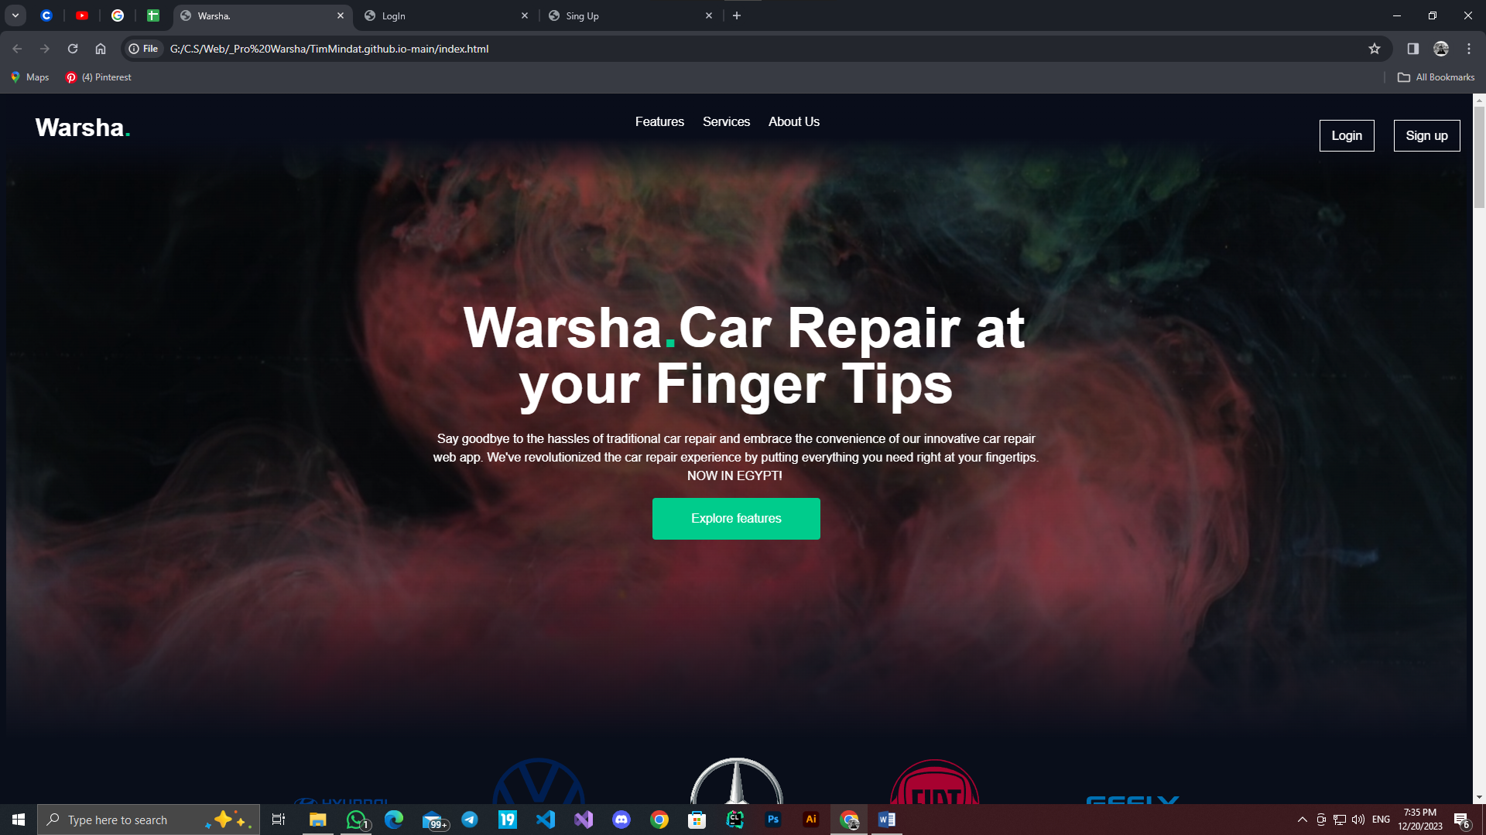

Slide 21
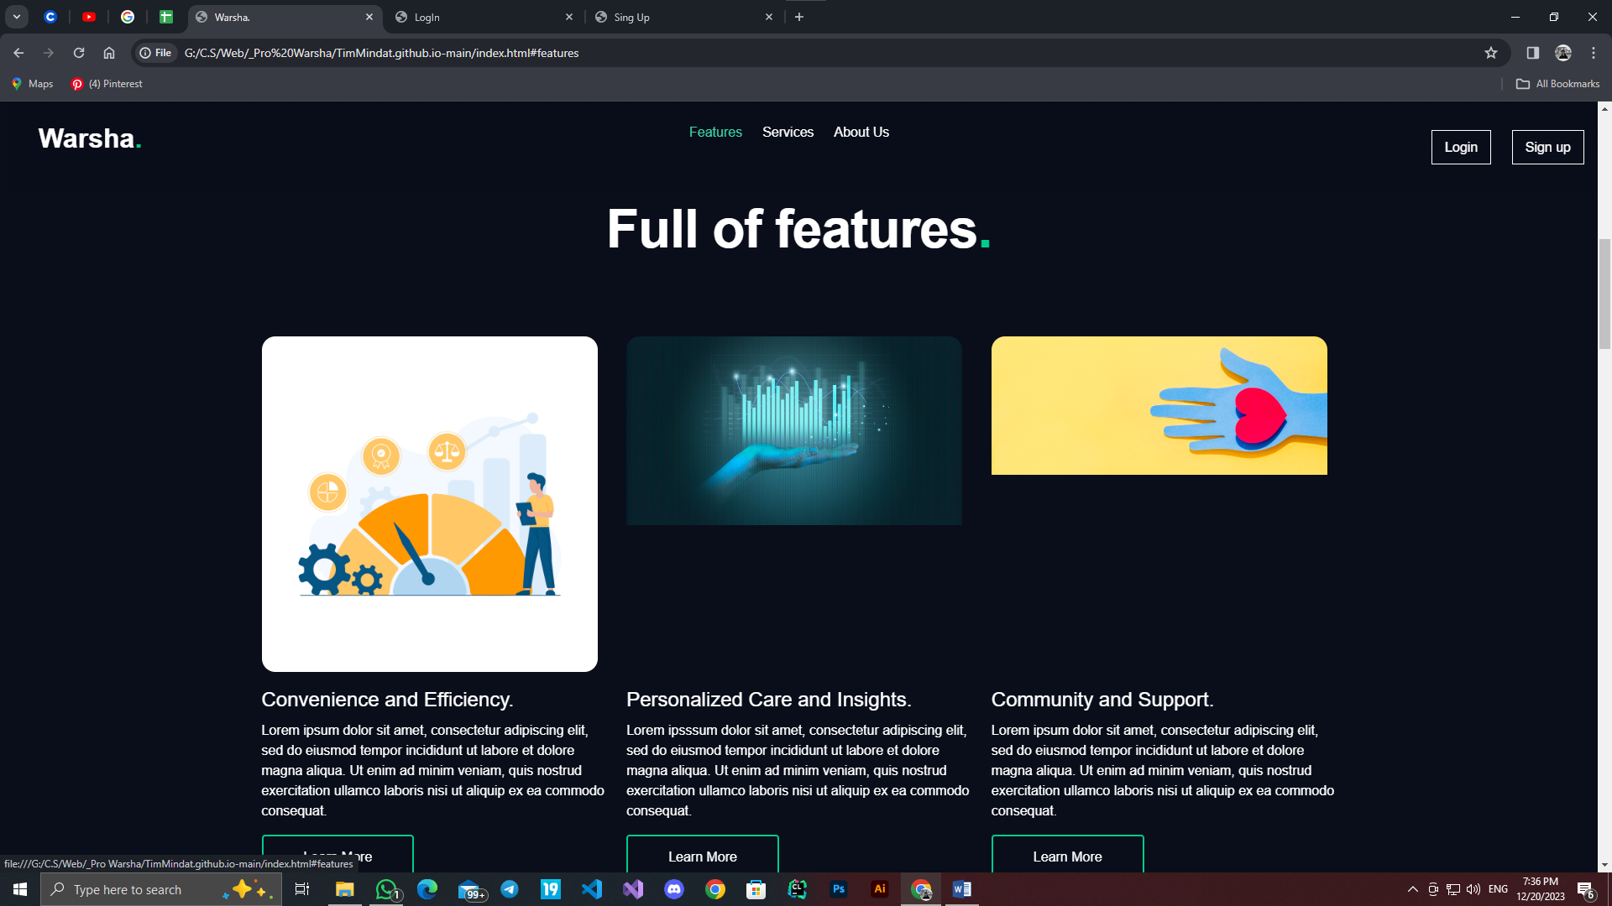

Slide 22
Thanks
Felopater Sameh Salama
Mohamed Mongy Mahmoud
Ali Omer Mohamed
Fady Al-Amir Sadek
Ali Mustafa Ahmed
Abdelrahman Tarek

